Slide 1

Recognition assembly – Years 4, 5 & 6
27th September 2024

Slide 2
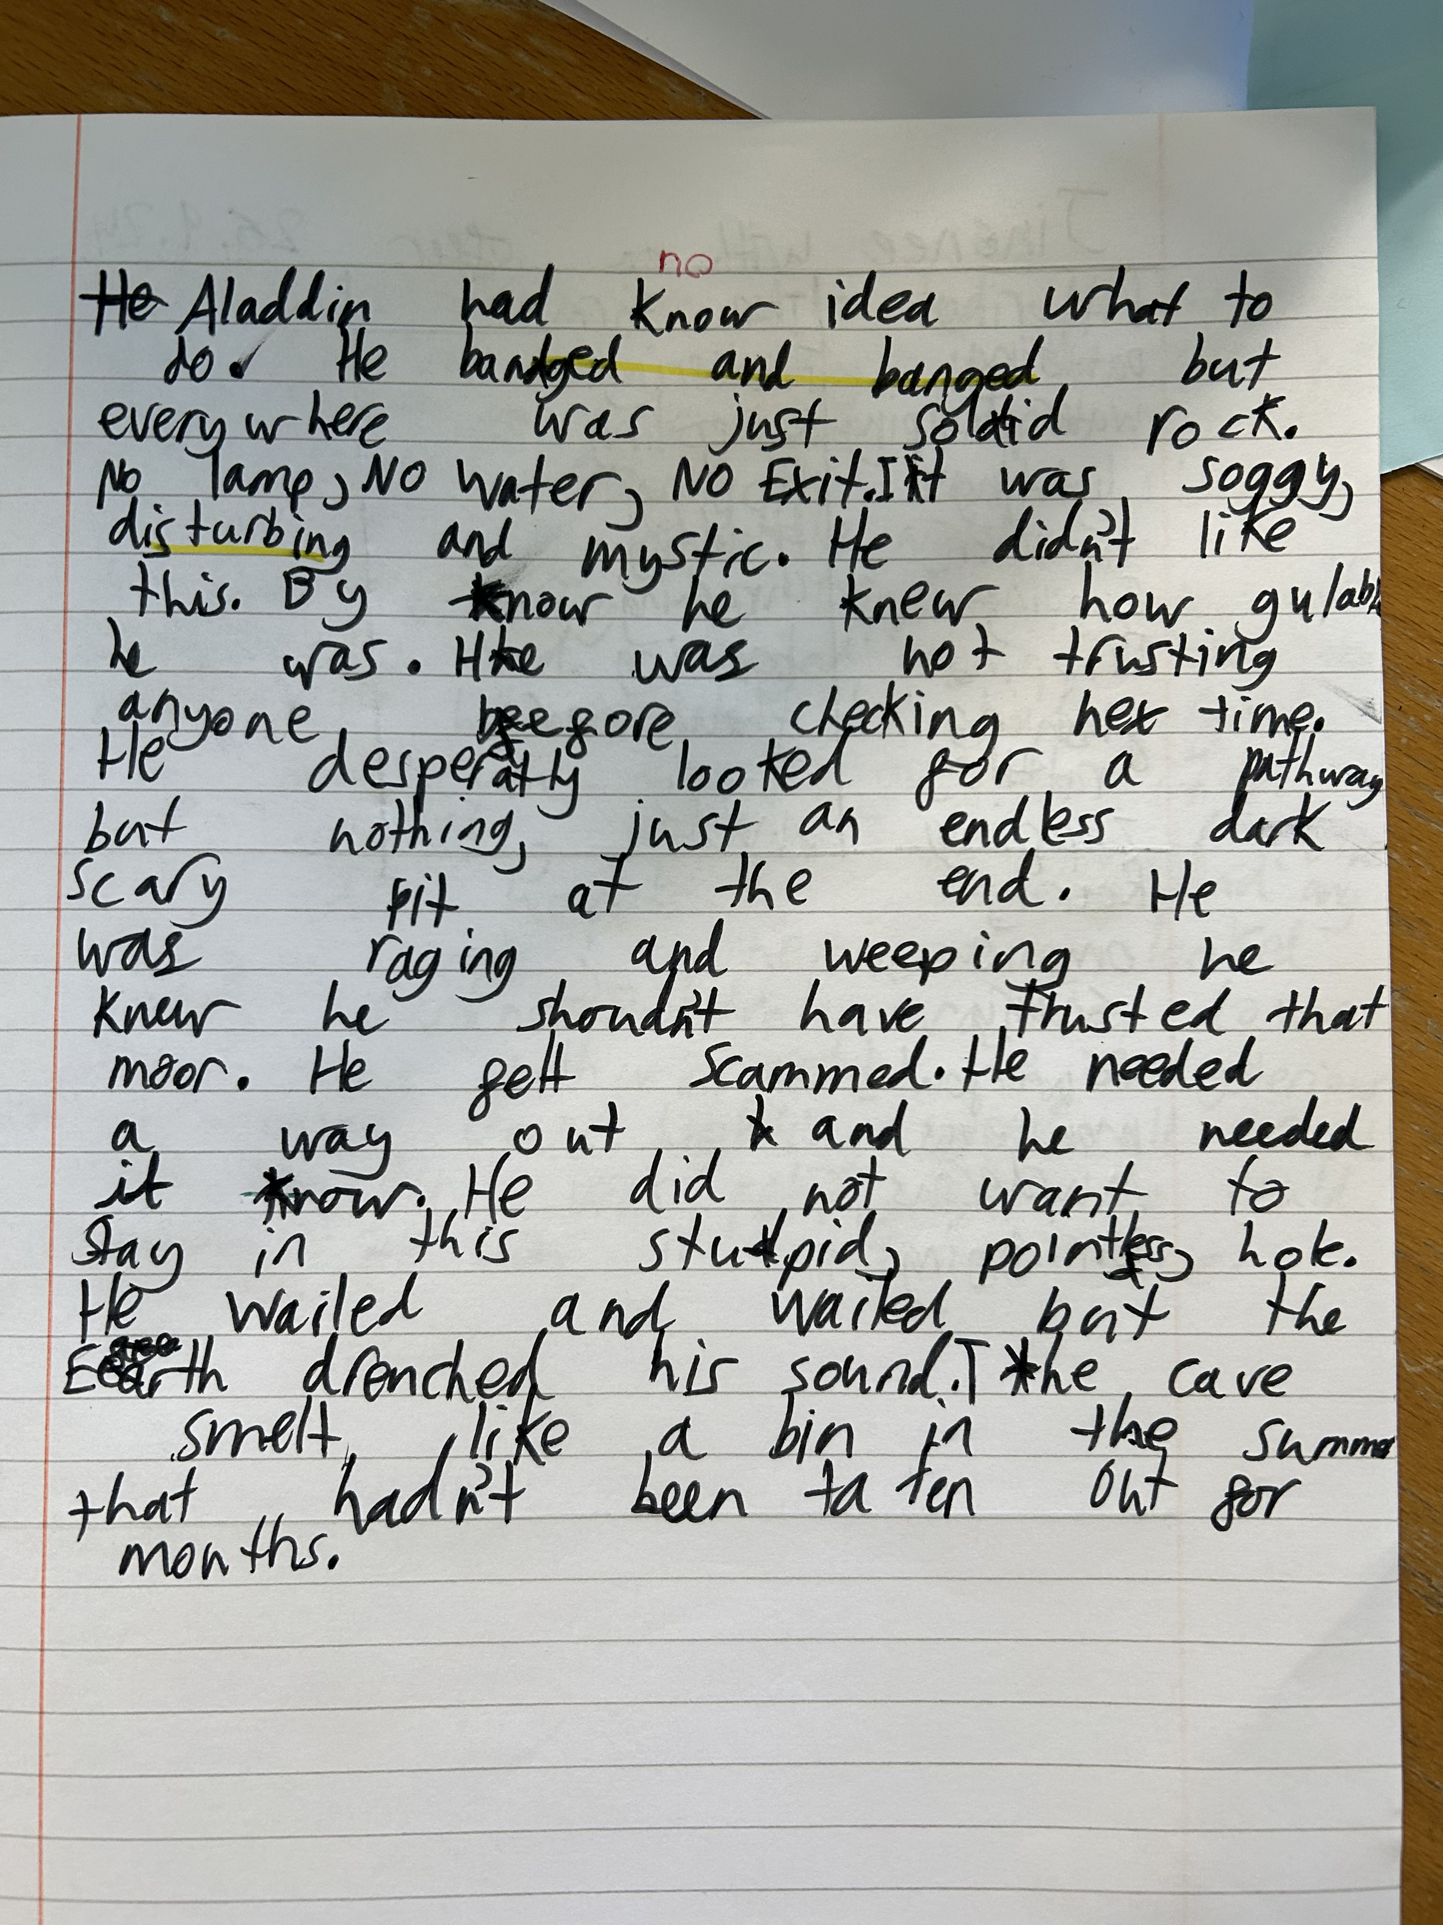
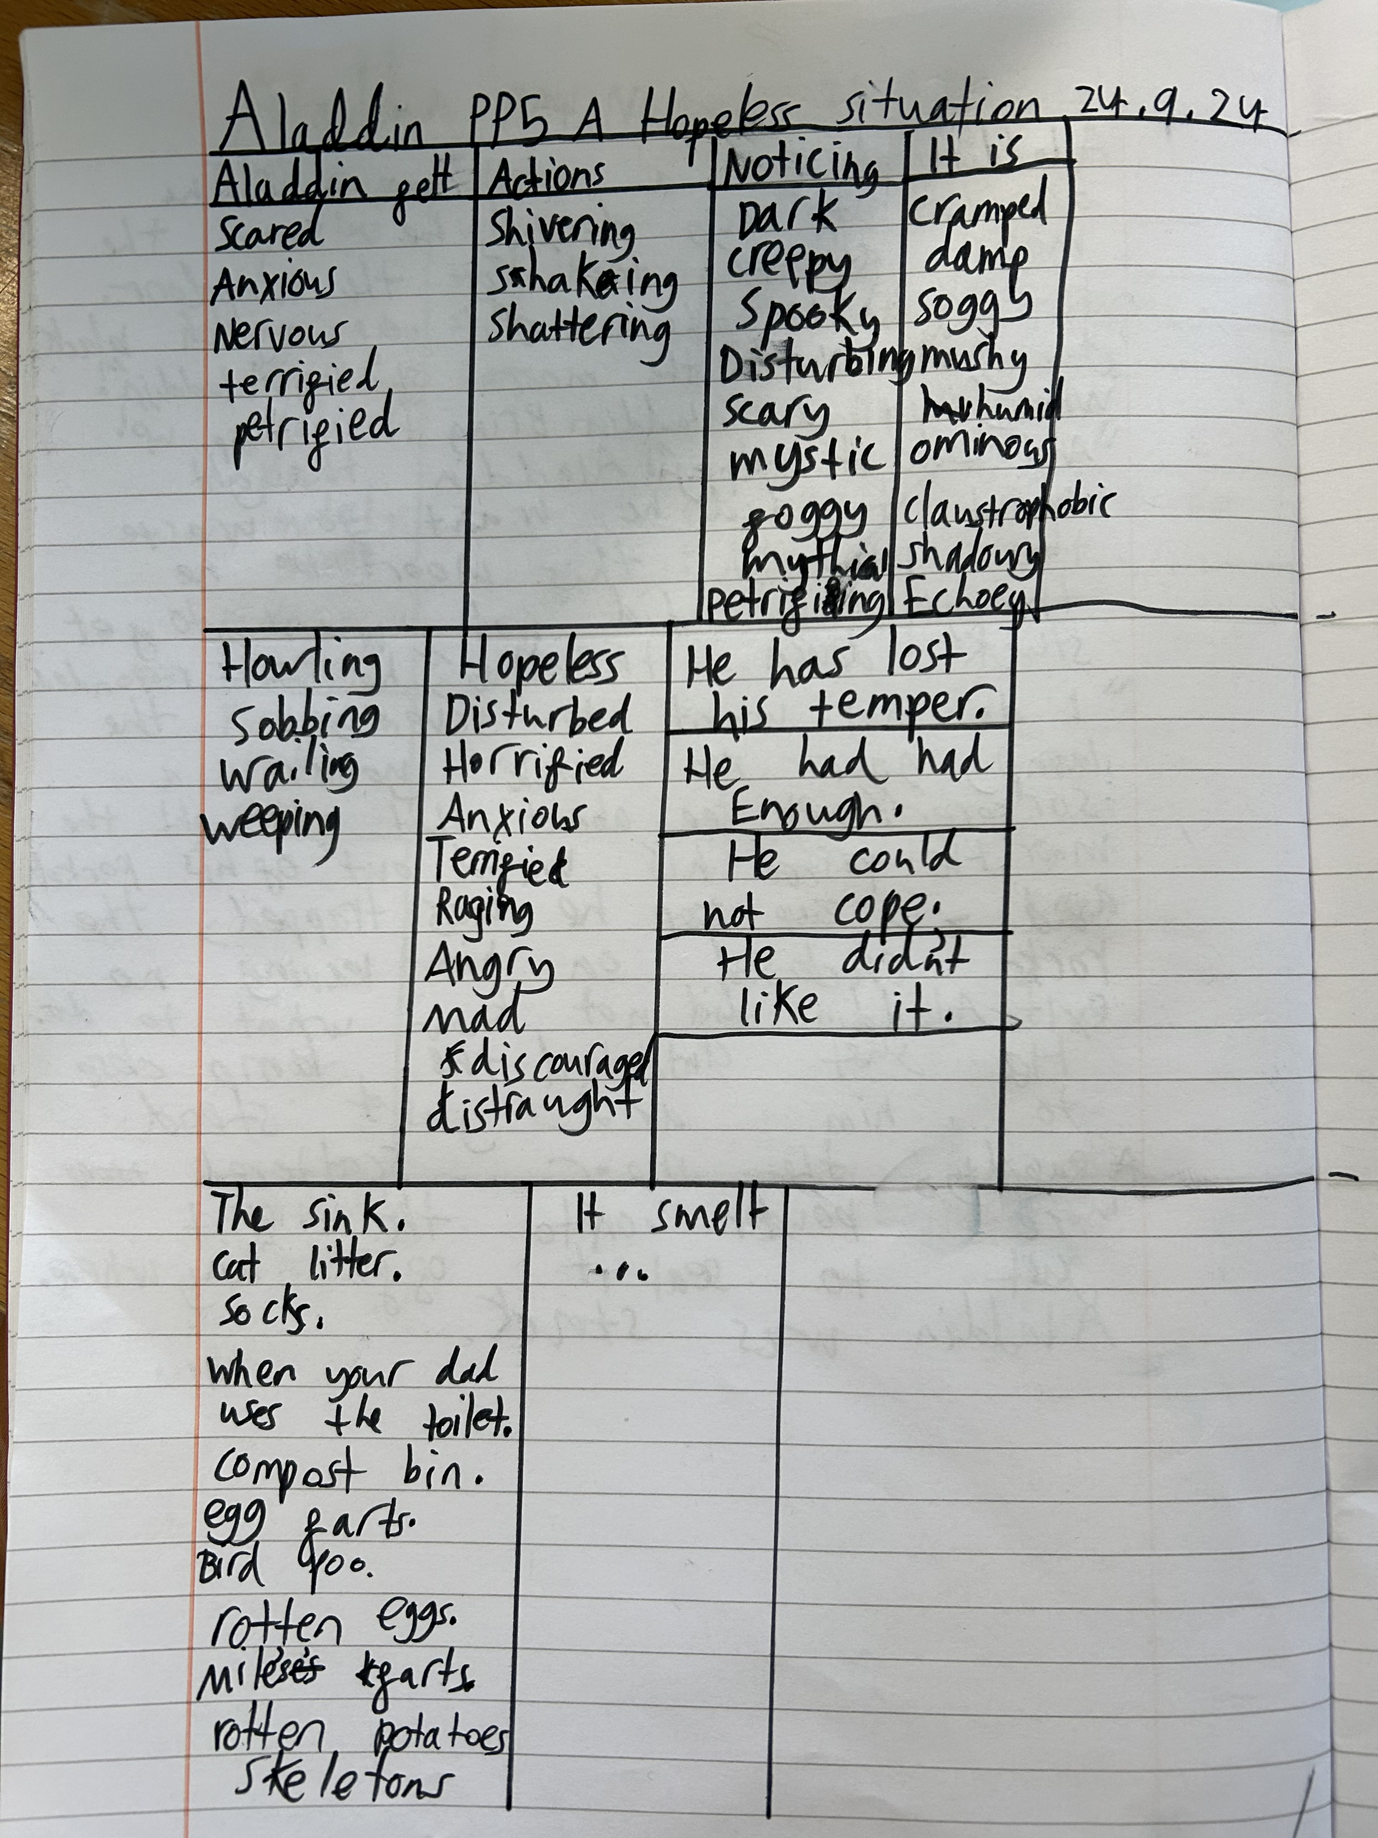
Year 4

Slide 3
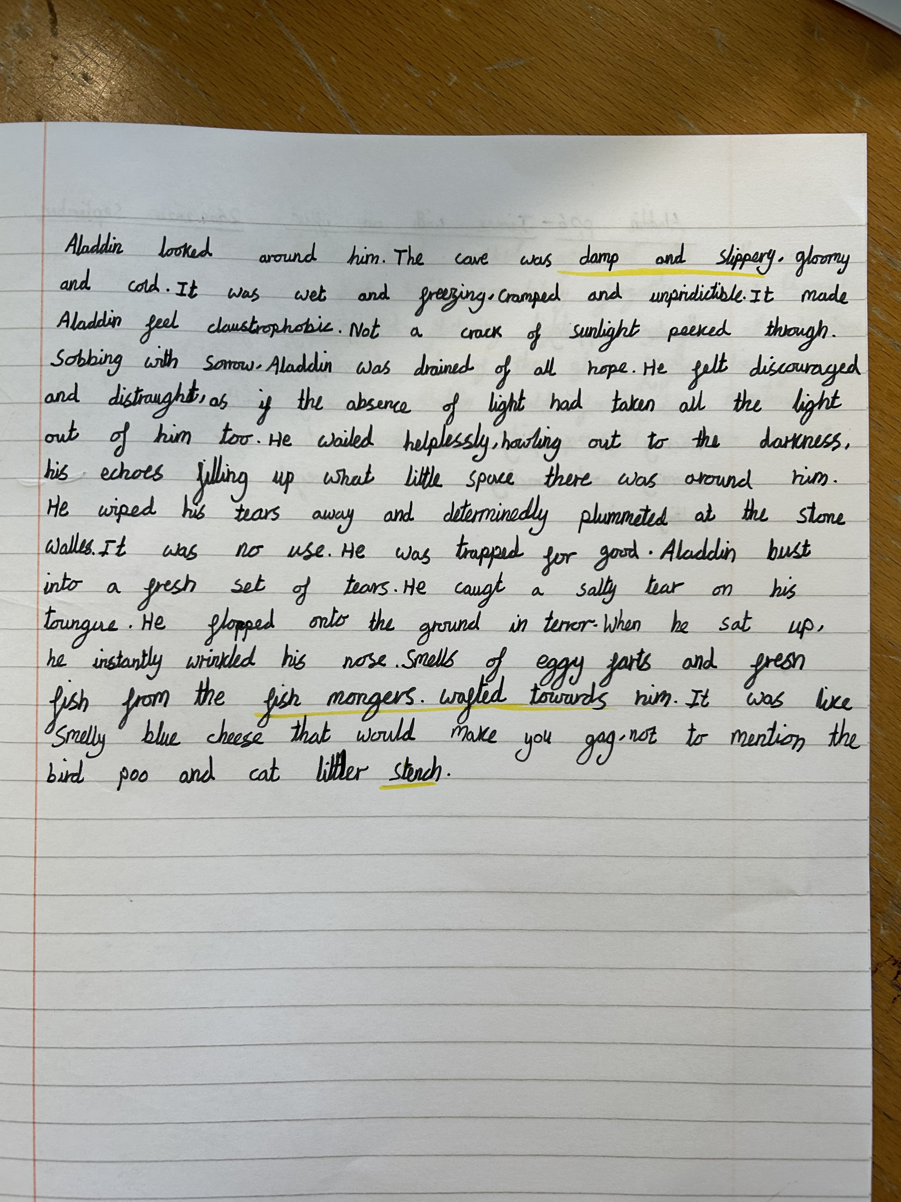
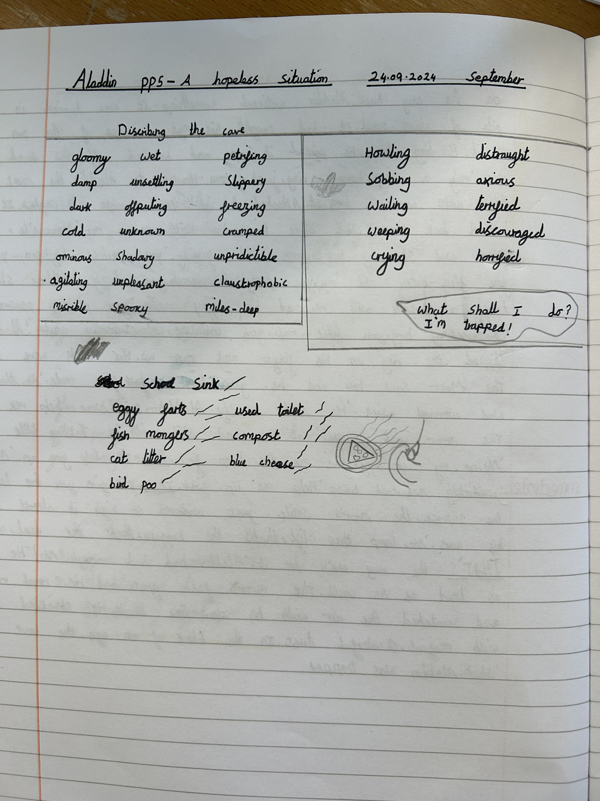
Year 4

Slide 4
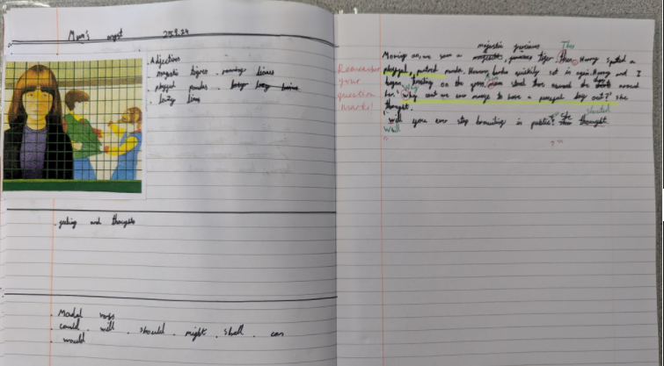
Year 5

Slide 5
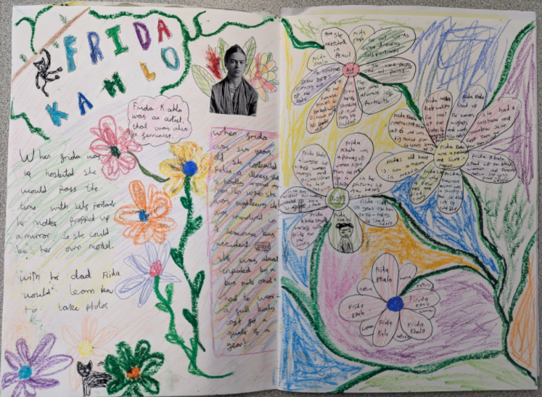
Year 5

Slide 6
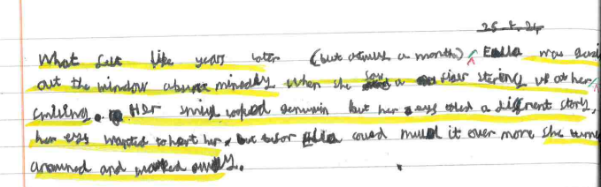
Year 6
What felt like year later (but actually a month), Ella was gazing out the window absent-mindedly when she saw a figure staring up at her, smiling. Her smile looked genuine but her eyes told a different story, her eyes wanted to hurt her. But before Ella could mull it over even more she turned around and walked away.

Slide 7
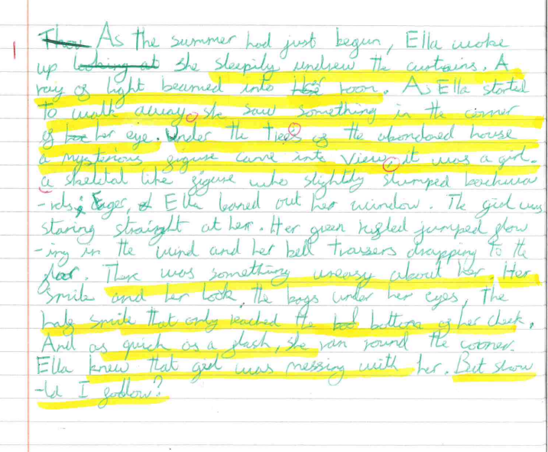
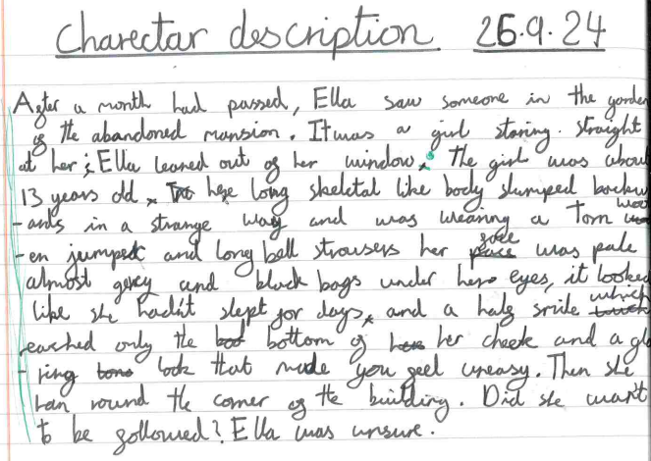
Year 6

